Slide 1

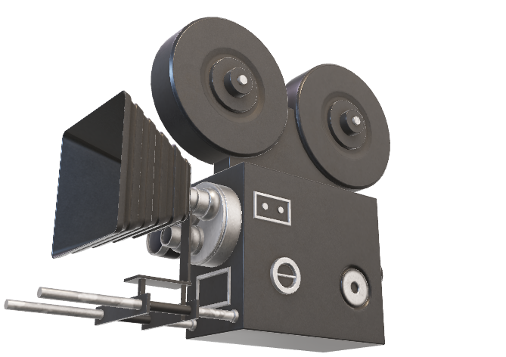
So, you want to make movies?
We are here to help ☺

Slide 2
Business Understanding
Box Office Analysis
Content Production Insights
Established Studios
Results and Recommendations
Genres by Revenue
Film Company Production
Run time
Timing of Release
Next Steps….

Slide 3
Different Starting Datasets
IMBD
Rotten Tomatoes
Box Office Mojo
The Movie Database
The Numbers
Movie Data

Slide 4
Sources of Data
Kaggle: Movie Data
Movie Basics
Movie Budgets
Measure 5000 films from 2008-2020

Slide 5

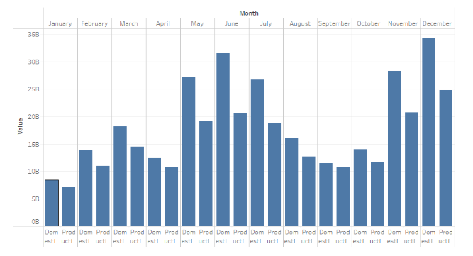

Revenue Generation by Month

Slide 6
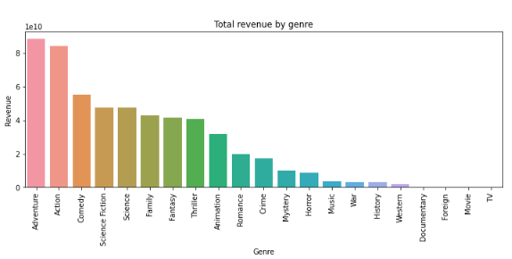

Slide 7
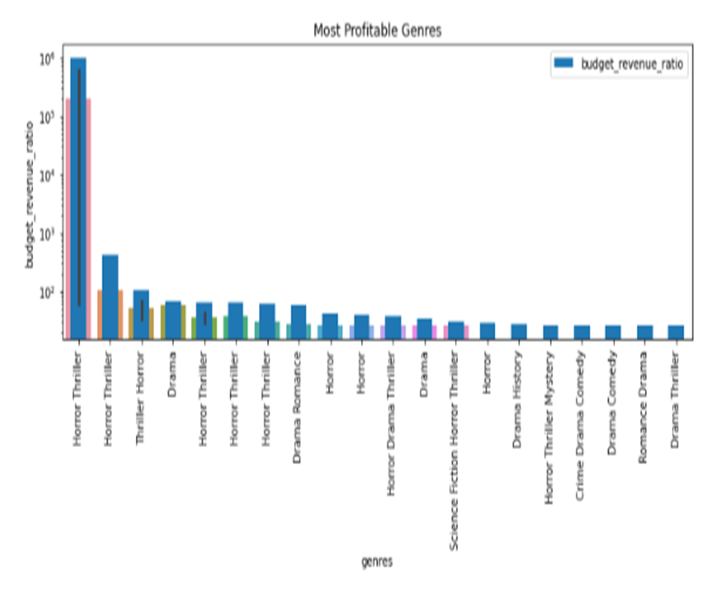



Slide 8

Average Costs of Starting a Film Production Company
Small Film Company | $10,000 - $50,000
Medium Film Company | $50,000 - $100,000
Large Film Company | $1,000,000 +

Slide 9
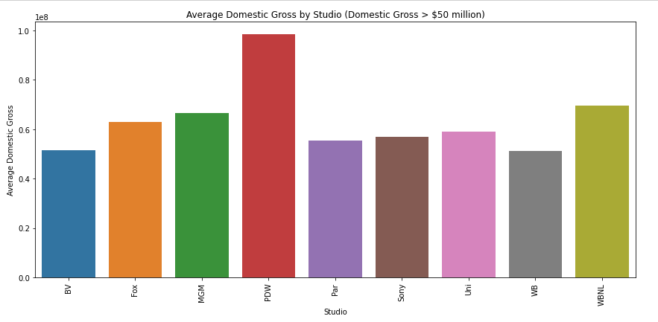

Slide 10



Conclusion
Horror, Mystery, Drama
Partner up with established companies
Low Risk, High Reward

Slide 11

Thank You
Johnathan Yater
&
Lotus Baumgarner

